Slide 1

Introduction to Backend Development Mercu Buana University
Taufik Mulyawan - Web Lead

Slide 2
Let me introduce myself
Mercu Buana University
Education
2021
2022
Jobs
Co-Founder & CTO
(Afaslearn)
Back-End Developer
(Workslab ID)
Instructor Back-End Developer
(Vocasia)
Back-End Developer
(Appsensi)

Slide 3
Prerequisites
Introduction to Backend Development Mercu Buana University

Slide 4
Prerequisites
#Postman #NodePackageManager #VisualStudioCode
Before we continue the hand on session, please download & install the tool below.
Visual Studio Code
Postman
Node Package Manager

Slide 5
Individual Project
#IndividualProject #Livecode
There are several individual project cases, prepare yourself.
Material on Slide
Live code session
Individual Project
Introduction to Google Solution Challenge
Projects are collected via the Github repository, you can ask questions via discord.

Slide 6
What is Back-End Development?
Introduction to Backend Development Mercu Buana University

Slide 7
What is Back-End Development
#Back-End
Back-End is part of the application that is responsible for providing needs that are invisible to the user (not interacting directly with the user), such as how data is stored, processed, and transacted securely. It all aims to support Front-End applications work according to their functions. People who work in this field are called Back-End Developers.
Back-End is an option field in the Software Developer profession. You need to determine what to focus on. So what do those terms mean in application development? Okay, let's discuss!!

Slide 8
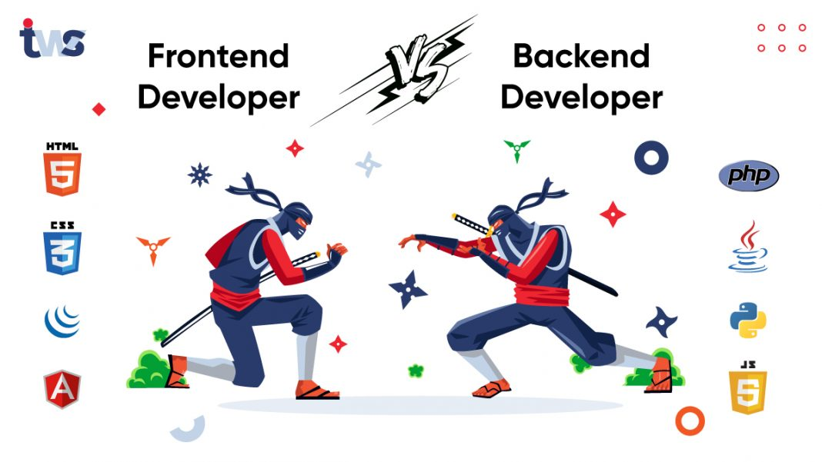

Slide 9
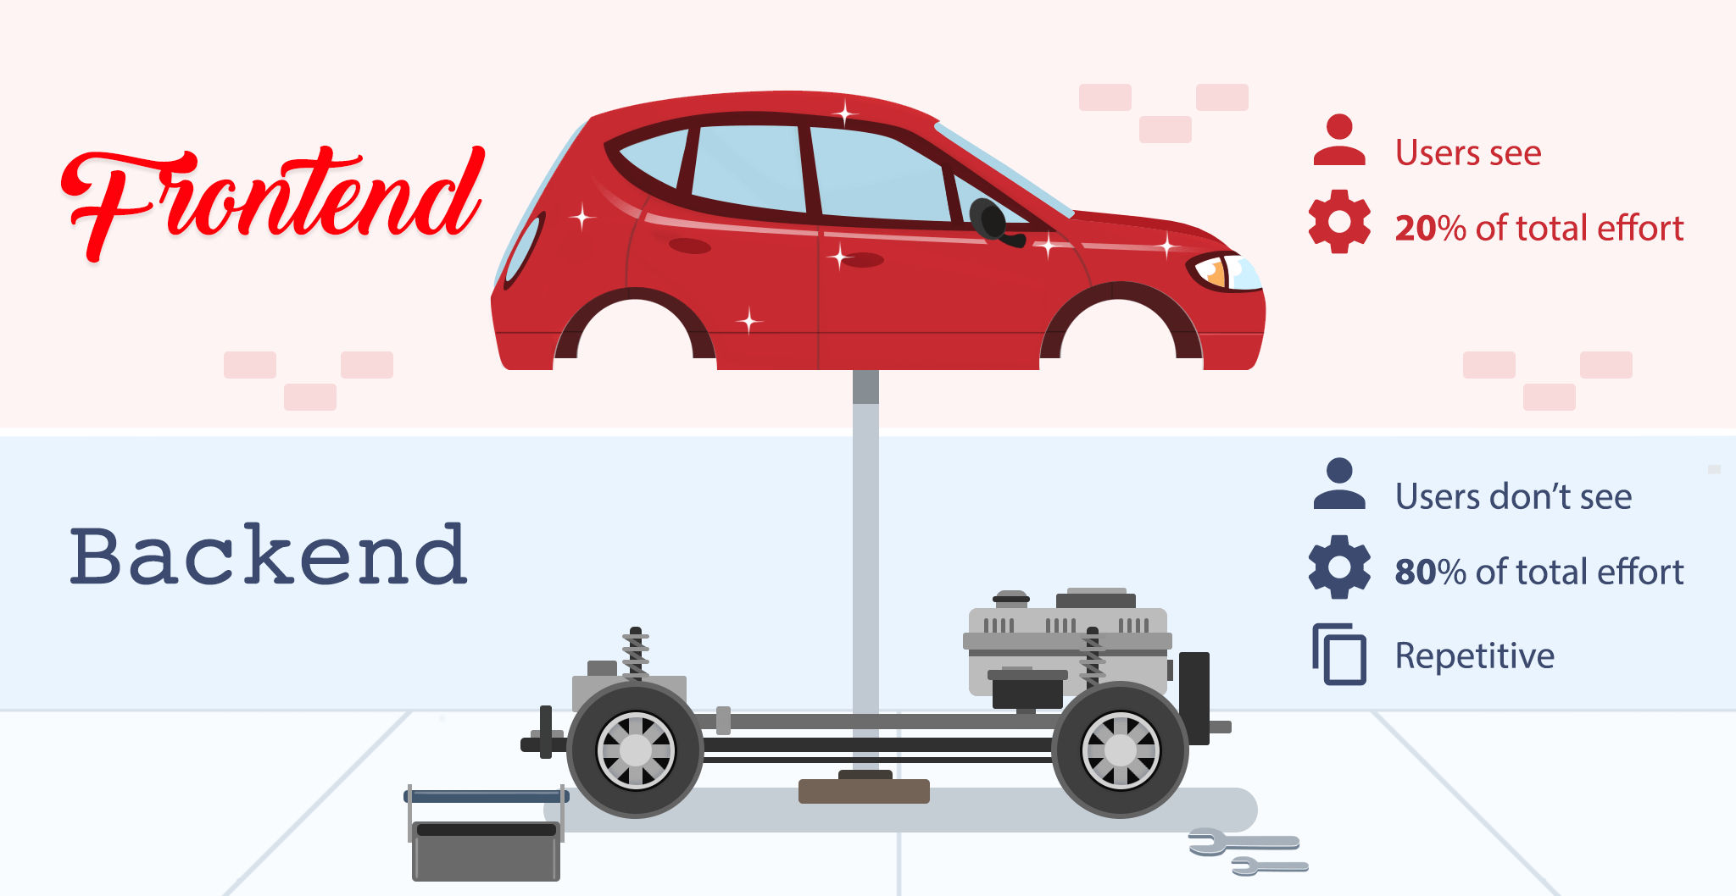

Slide 10
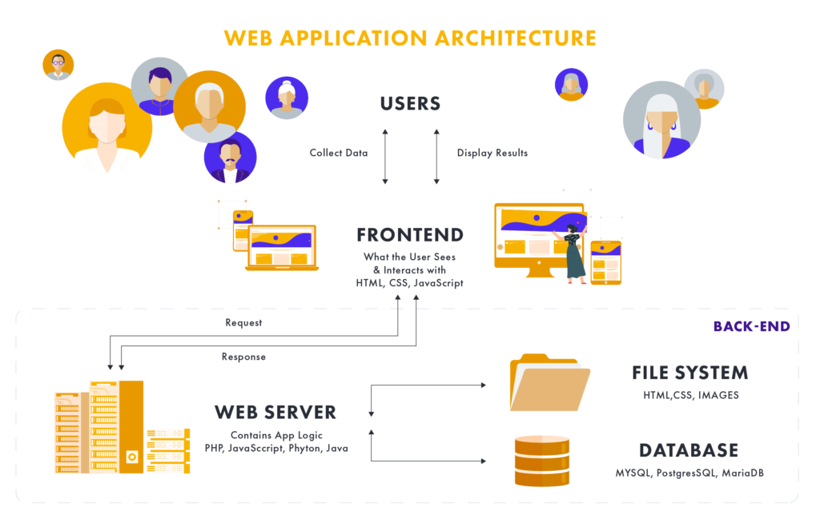

Slide 11
What is Node JS?
Introduction to Backend Development Mercu Buana University

Slide 12
What is Node JS?
#Back-End #NodeJS
Node. js (Node) is an open source development platform for executing JavaScript code server-side. Node is useful for developing applications that require a persistent connection from the browser to the server and is often used for real-time applications such as chat, news feeds and web push notifications.
Node.js is actually not a framework or a library, but a runtime environment, based on Chrome’s V8 JavaScript engine.

Slide 13
Express JS
#Back-End #ExpressJS
Express JS is a framework derived from the JavaScript programming language that is designed flexibly and minimally, for the development of back-end applications. The framework developed from Node JS can provide convenience in making server-side applications. Also, Express JS is the basic library of the Node JS framework.
With Express JS, programmers no longer need to create web applications using Node.JS' built-in http module. Framework with a series of interesting features, such as routing, rendering views, and supported by this middleware can save time in developing Node.JS applications. This library also makes it easy to build back-end systems, and gives developers the freedom to design applications.

Slide 14
Web Service
Introduction to Backend Development Mercu Buana University

Slide 15
Web Service
#WebService
Web service is an application that contains a collection of databases and software or parts of software programs that are accessed remotely by devices with certain intermediaries. Through web services, it allows users to overcome problems in the form of interoperability and integrate different systems.
In general, web services have a special feature in the form of a URL like a web. What makes the difference is the interaction provided by the web service itself. URLs in web services only contain a set of information, commands, and configurations (syntax that is useful for building certain functions of the application).

Slide 16
RESTful API
#RESTful API
A RESTful API is an interface used by two computer systems to exchange information securely over the internet. Most business applications must communicate with internal applications and other third parties to perform various tasks. For example, to generate monthly payslips, your internal account system must share data with your customer's banking system to automate billing and communicate with the internal timesheet application. RESTful APIs support this exchange of information because they follow secure, reliable and efficient software communication standards.

Slide 17
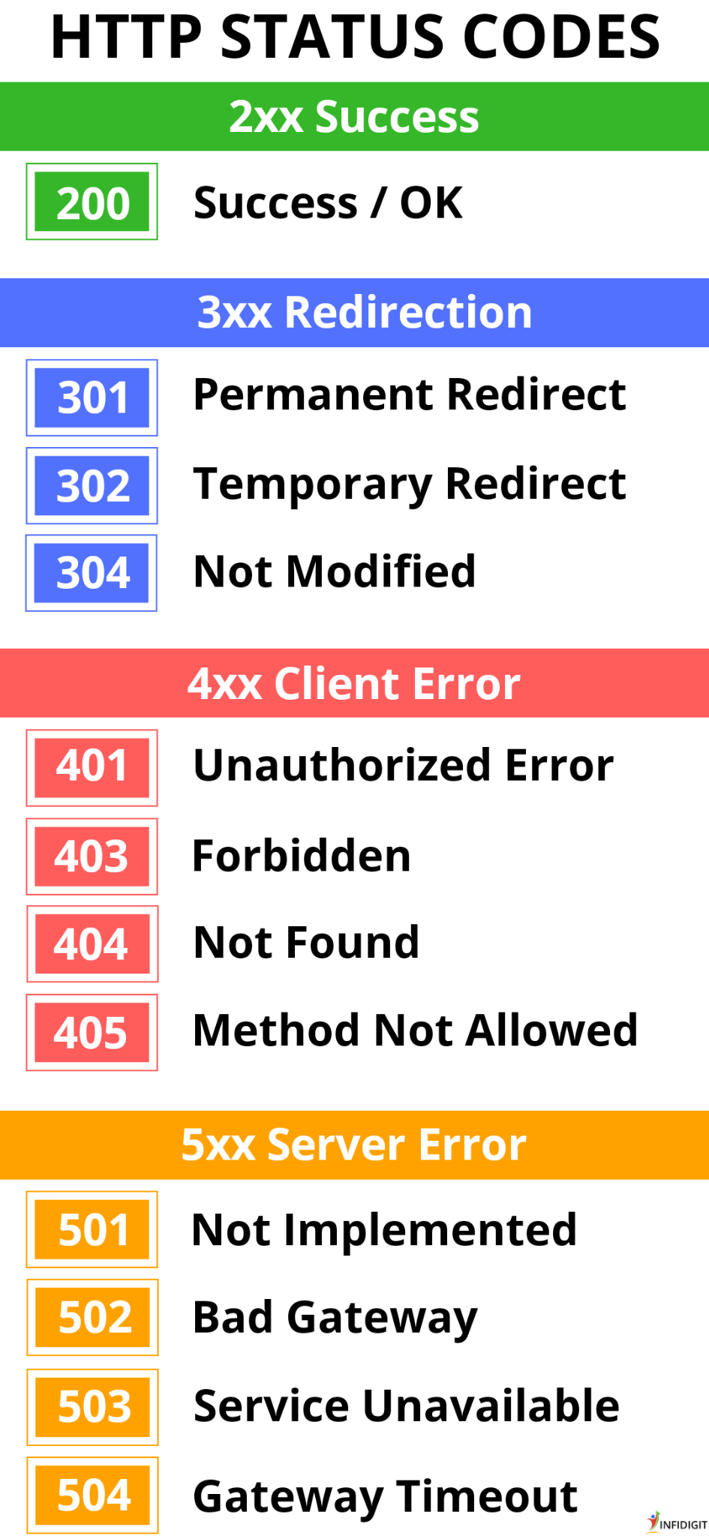
HTTP Response Code
#ResponseCode

Slide 18
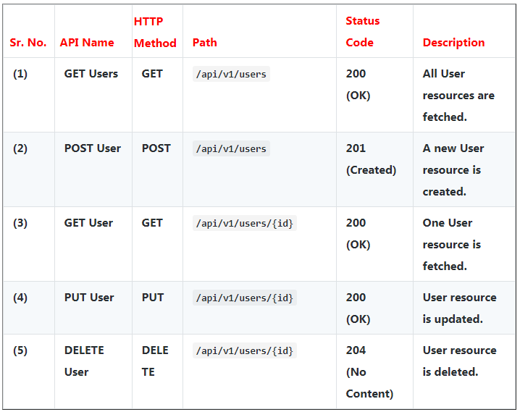
URL Design
#URLDesign

Slide 19
Cross-Origin Resource Sharing (CORS)
Introduction to Backend Development Mercu Buana University

Slide 20
Cross-Origin Resource Sharing (CORS)
#CORS #CrossOriginResourceSharing
Cross-Origin Resource Sharing (CORS) is an HTTP-header based mechanism that allows a server to indicate any origins (domain, scheme, or port) other than its own from which a browser should permit loading resources. CORS also relies on a mechanism by which browsers make a "preflight" request to the server hosting the cross-origin resource, in order to check that the server will permit the actual request. In that preflight, the browser sends headers that indicate the HTTP method and headers that will be used in the actual request.

Slide 21
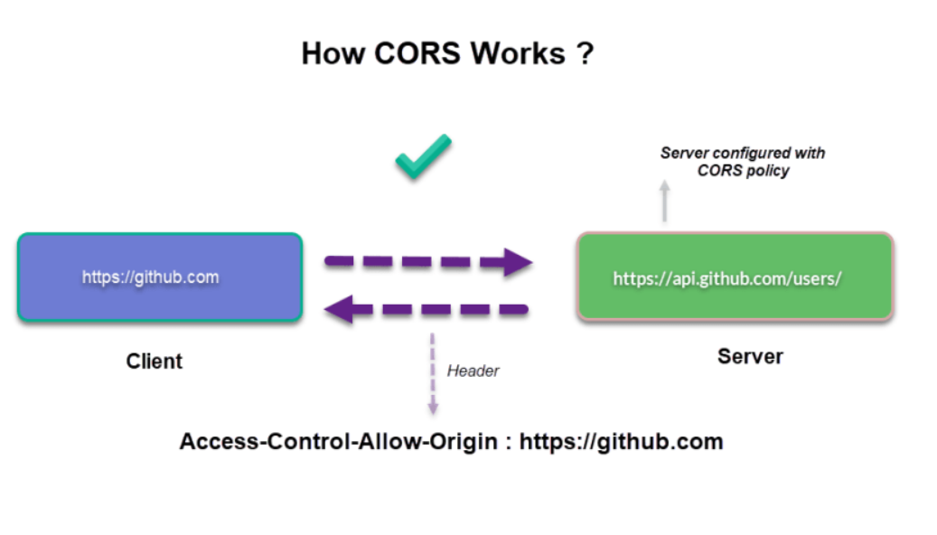

Slide 22
Node Package Manager
Introduction to Backend Development Mercu Buana University

Slide 23
Node Package Manager
#NodePackageManager
Node Package Manager (NPM) is a package manager for JavaScript that can make it easier for us to manage packages available at https://www.npmjs.com. NPM is a standard package manager provided by Node.js and is automatically installed when installing Node.js on our computers.
Almost every popular programming language has its own package manager. Java has Maven and Gradle, PHP has Composer, and Python has pip. Then what about JavaScript? Of course JavaScript has too! NPM is a package manager that is widely used by JavaScript developers in managing packages. In addition to NPM there is also a Yarn Package Manager.

Slide 24
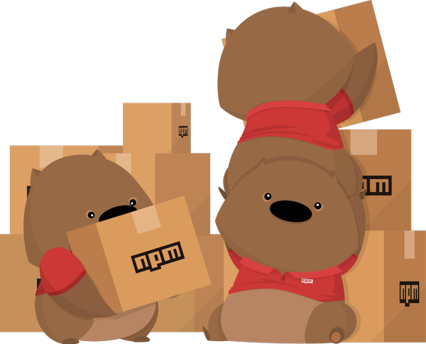
Let’s talk more about Node Package Manager!!!

Slide 25
Firebase
Introduction to Backend Development Mercu Buana University

Slide 26
Firebase
#Firebase #Firestore #Spark #Blaze
Firebase is a service from Google to provide convenience and even make it easier for application developers to develop their applications. Firebase aka BaaS (Backend as a Service) is a solution offered by Google to speed up developer work.
Backend as a Service itself is a category of cloud services that manages the backend of applications. This means that Firebase as BaaS will take care of everything regarding the backend such as databases, authentication, hosting, APIs and others.
With Firebase, developers can focus more on building the front-end of the app. Because, the backend side will be done using Firebase more practically.

Slide 27
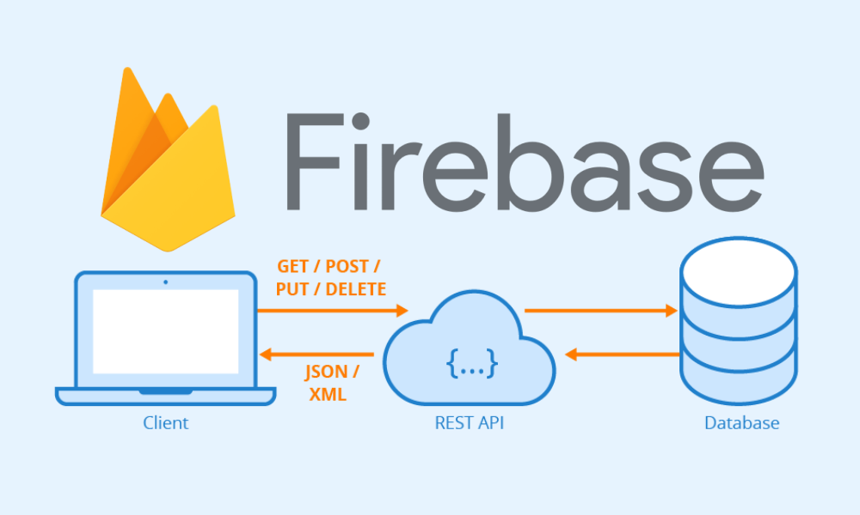

Slide 28
Postman
Introduction to Backend Development Mercu Buana University

Slide 29

Sorry, not this one
I mean postman for RESTful API design
Well.. I’m just kidding :D
Let discuss about the real Postman!

Slide 30

Let’s talk about Postman!

Slide 31
Postman
#Postman #RESTful-API
Postman is a computer application used for API testing. Postman sends an API request to the web server and receives a response, whatever it is. No additional work or framework setup is required when sending and receiving requests in Postman. Widely used by Testers and Developers for better testing of apps. Easily integrates with your Continuous Integration (CI) & Continuous Development Pipeline.
Postman with a number of features and ease of work, has been used by millions of testers. Using a simple and user-friendly interface, you can easily send a request, just fill in the required data, select the HTTP method and press the "Submit" button. Another of the most used features is Automation, which allows you to set up tests and write test suites.

Slide 32
Live Code
Introduction to Backend Development Mercu Buana University

Slide 33
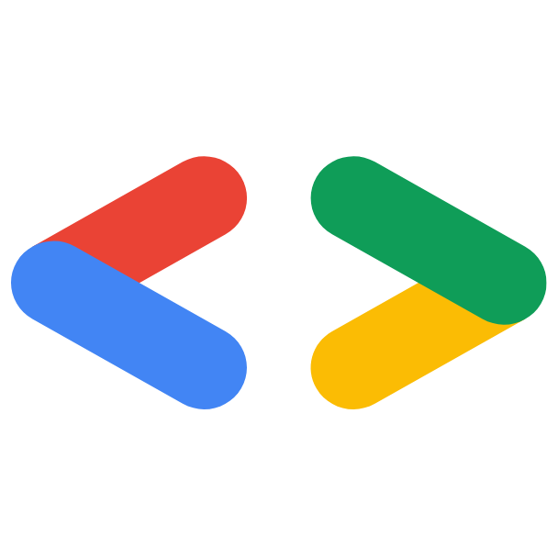

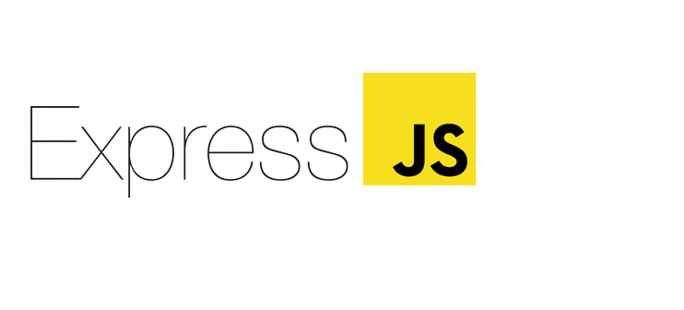
Let’s Code!!
#Code #LiveCodeSession

Slide 34
Individual Project
Introduction to Backend Development Mercu Buana University

Slide 35
Unfortunately the project that we make is not perfect. There are still many improvements from the project!
Please make improvements to the project, by following the criteria below:
1) When you want to update and the user is not found in firebase, give the output that the user is not found in the postman response. (Mandatory)
2) When you want to delete and the user is not found in firebase, give the output that the user is not found in the postman response. (Mandatory)
3) Implement URL design on each endpoint following best practice guidelines. (Mandatory)
4. Get all data from Firebase (Mandatory)
5) Apply try & catch on each endpoint, so that all error input can be read in postman response. (Plus point, if you can implement it - Optional)

Slide 36
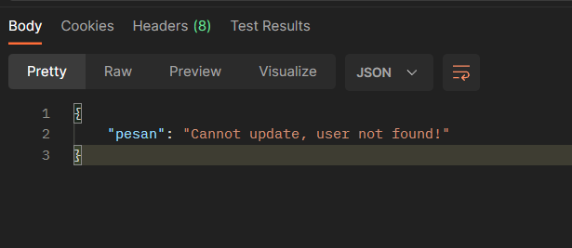
Clue no #1
#Clue #Postman

Slide 37
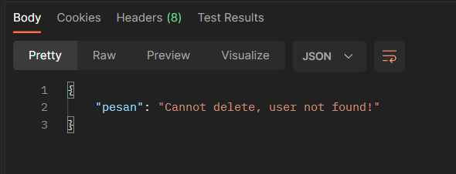
Clue no #2
#Clue #Postman

Slide 38
Clue no #3
#Clue #Postman

Slide 39
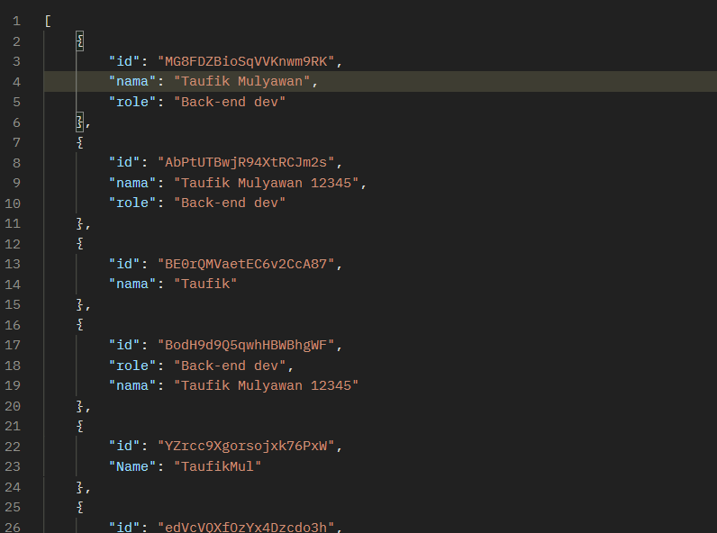
Clue no #4
#Clue #Postman

Slide 40
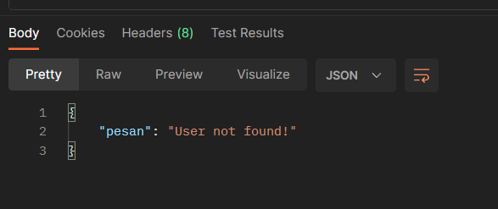
Clue no #5 (Optional - Plus point)
#Clue #Postman
Catch will output an error according to the error listed. In this way, we don't need to list one part at a time where any errors will occur.

Slide 41
Send your project via discord (Taufik)
The project you sent is a link to your Github Repository (if you have one)
Feel free to ask through the discussion forum on discord if you want to ask about the assigned task!
We are sure that all of you can do the task! Keep it up, and make your way like a developer!
Projects that you collect will be reviewed and prioritized to take part in the Google Solution Challenge 2023

Slide 42
Q & A
Introduction to Backend Development Mercu Buana University

Slide 43
Any Question? Please open slido!

Slide 44
Quiz
Introduction to Backend Development Mercu Buana University

Slide 45
Quiz Introduction to Backend Development
#Code #LiveCodeSession
It's quiz time!!!

Slide 46
Google Solution Challenge
Introduction to Backend Development Mercu Buana University

Slide 47
Google Solution Challenge
#GSC #GoogleSolutionChallenge
The Google Developer Student Clubs 2022 Solution Challenge mission is to solve for one of the United Nations’ 17 Sustainable Development Goals using Google technology.
Created by the United Nations in 2015 to be achieved by 2030, the 17 Sustainable Development Goals (SDGs) agreed upon by all 193 United Nations Member States aim to end poverty, ensure prosperity, and protect the planet.
This year, see how you can use Android, Firebase, TensorFlow, Google Cloud, Flutter, or any of your favorite Google technologies to promote employment for all, economic growth, and climate action, by building a solution for one or more of the UN Sustainable Development Goals.

Slide 48
Who can participate?
#GSC #GoogleSolutionChallenge
18+ years of age
Part of an active DSC (that's us!)
You can work with teammates from your DSC or even other DSCs. The submission form collects the team name and teammate emails
Teams are limited to a maximum of 4 members

Slide 49
Why must participate?
#GSC #GoogleSolutionChallenge
The mission of the competition is to enable hands-on learning and inspire student developers to come together as a global community, learn, and build real solutions for real problems.
Benefits for Solution Challenge Program includes:
Portofolio 📄🌟
Advanced Skills 📒
Preparation for employment 🧑‍💼👩‍💼
Centralized Learning🧑‍🏫

Slide 50

Timeline
LEARN
BUILD
CONNECT
2022
September
October
December
February
April
July
2023
Class Onboarding
Solution Challenge start
Events and workshops
Graduation

